Slide 1

Brazilian E-Commerce Store
Epsilon AI Diploma
Final Project
An detailed Analysis approach to help Sales & Marketing
team make data driven decisions
Prepared by : Mohab Allam
Supervision : Eng. Abdelrahman Gaber

Slide 2
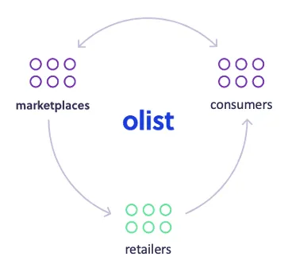
About Olist ?
About Olist ?
Olist is an e-commerce platform based in Brazil that allows small and medium-sized businesses to sell their products through various channels, including marketplaces, social media, and their own online store.

Slide 3
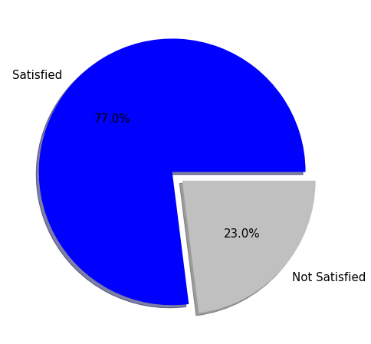
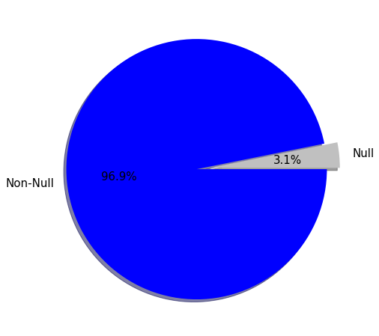
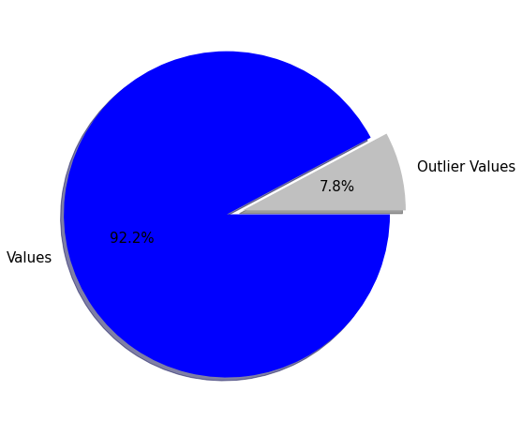
Dataset Overview
The dataset has information of 100k orders from 2016 to 2018 made at multiple marketplaces in Brazil. And consists of 23 Categorical & 13 Numerical features.
Imbalance
Missing Values
Outliers

Slide 4
Data Wrangling Stages
Data Wrangling
Stage 1
Stage 2
Stage 3
Load & Merge
Load all 9 datasets.
Merging all datasets together by inner join.
Data Cleaning
Handle missing values.
Handle outliers for some features.
Feature Engineering
Apply feature engineering for many features to better analyze the data

Slide 5
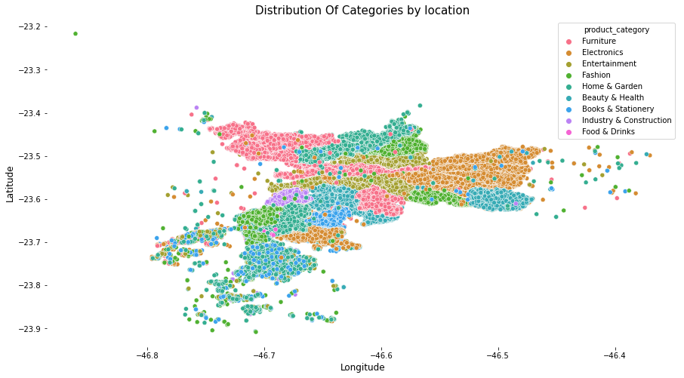
Data Analysis
How Olist store covers brazilian cities as per products categories ?

Slide 6
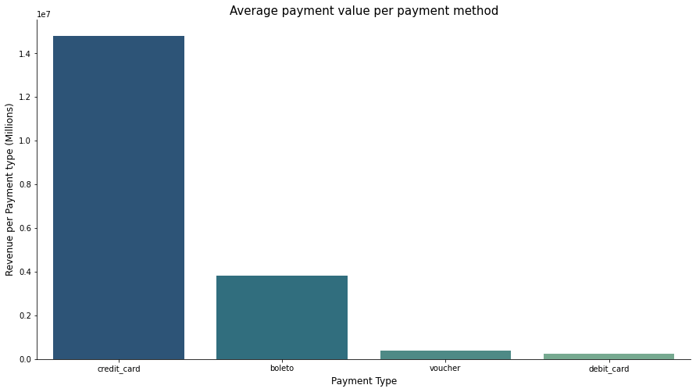
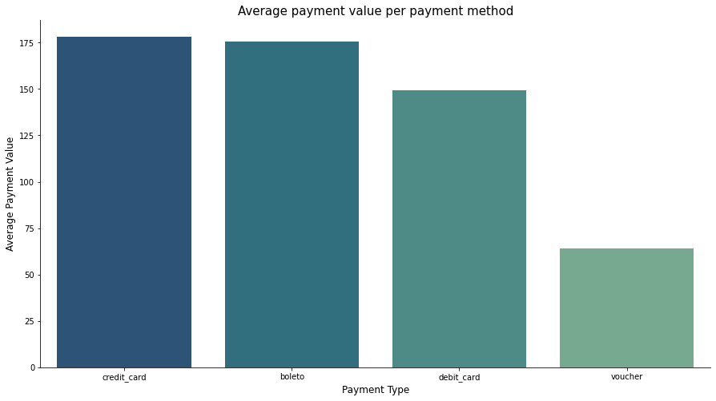
Data Analysis
Are customers more likely to make larger payments using certain payment methods ?

Slide 7
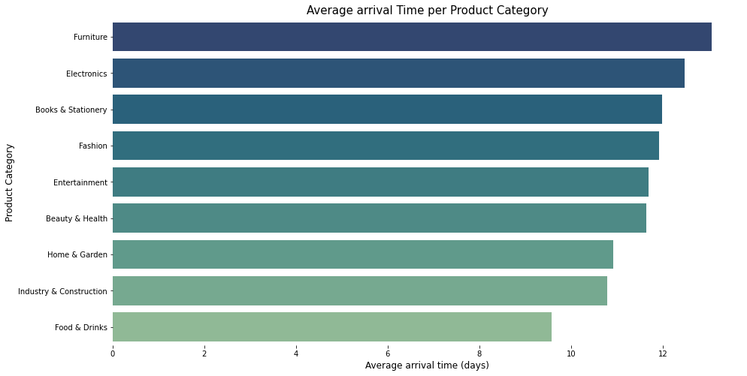
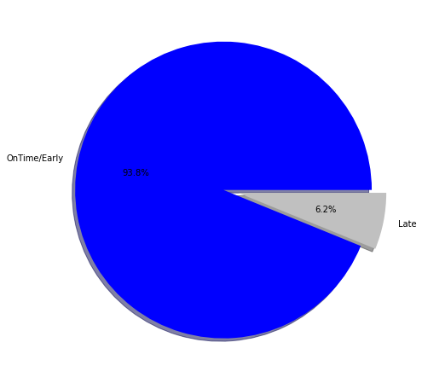
Data Analysis
How accurate are the estimated delivery dates provided to customers ?

Slide 8
Data Preprocessing
Drop Unnecessary features and features with High correlations.
Select best features to reduce Model Complexity
Handle Imbalance in data using SMOTE
Drop Features
Handle Categorical
Feature Selection
Feature Scaling
Handle Imbalance
Handle Categorical features either Nominal or Ordinal
Apply feature Scaling using Standard Scaler

Slide 9
Machine Learning
( Evaluation Metric used is Macro Avg F1 Score )
Tree Based
Gradient Boost
Models
Models
DT
RF
ADA
XGB
LIGHT GBM
CATBOOST
LR
KNN
Naive Bayes
65%
71%
61%
65%
65%
65%
62%
61%
62%
Best Model used After Hyperparameter tuning is XGBoost with 67% Macro Avg F1-score.

Slide 10
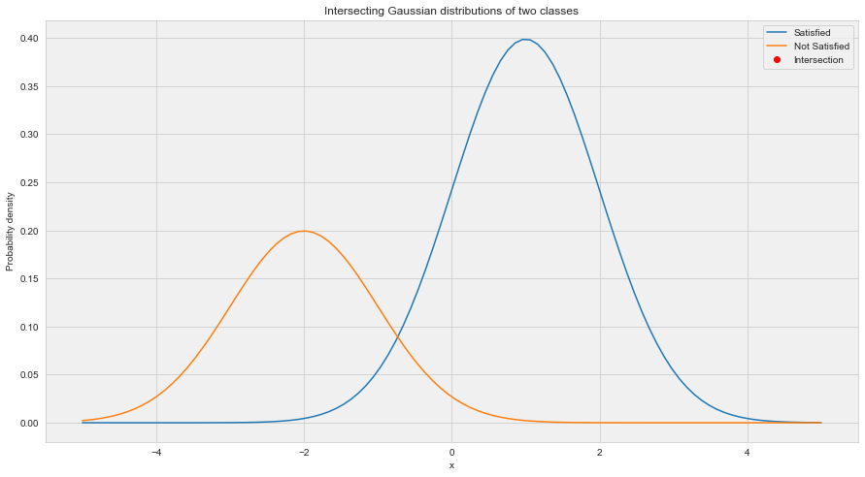
Machine Learning
( Evaluation Metric used is Macro Avg F1 Score )
We can conclude from the results that issues of bad performance on testing is not mainly because of Imbalance, but overlapping between two classes makes it difficult for ML models to classify them better.
So will use NLP approach on Customers reviews to investigate further.

Slide 11
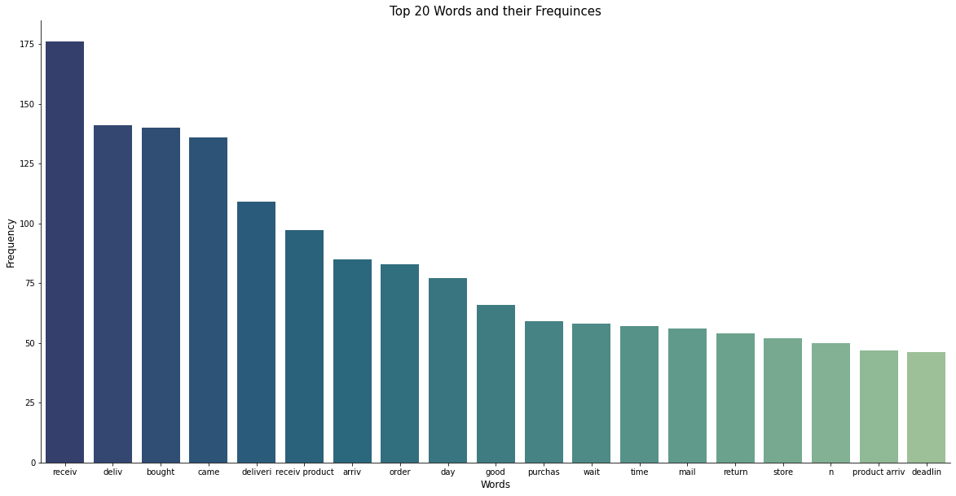
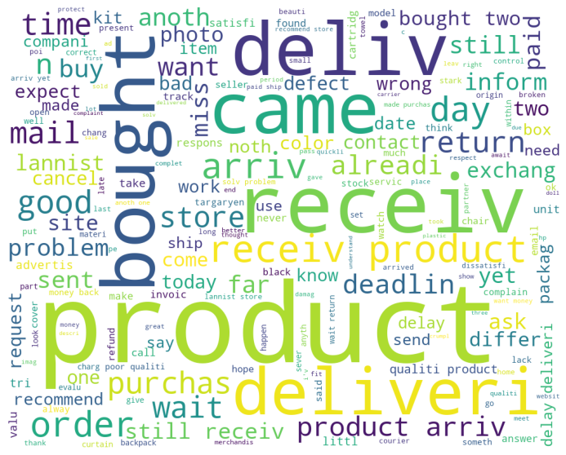
NLP Techniques
Applying NLP techniques on reviews data provides better results with MultinomialNB model (87% Macro Avg F1-Score)

Slide 12
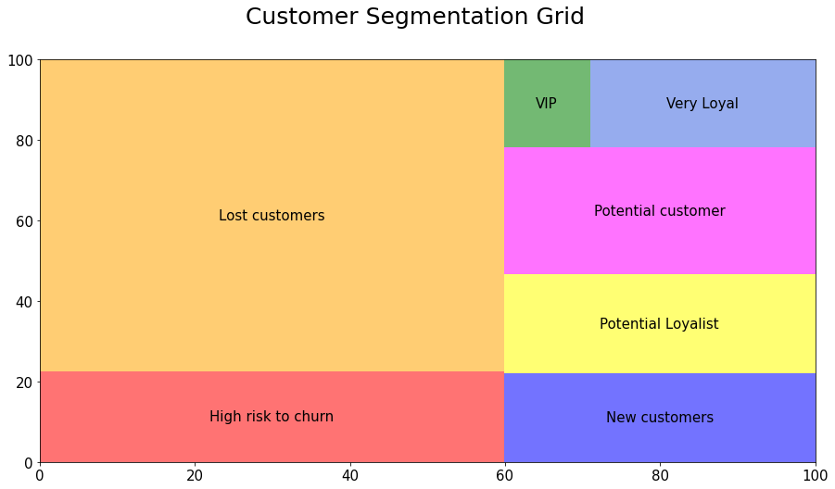
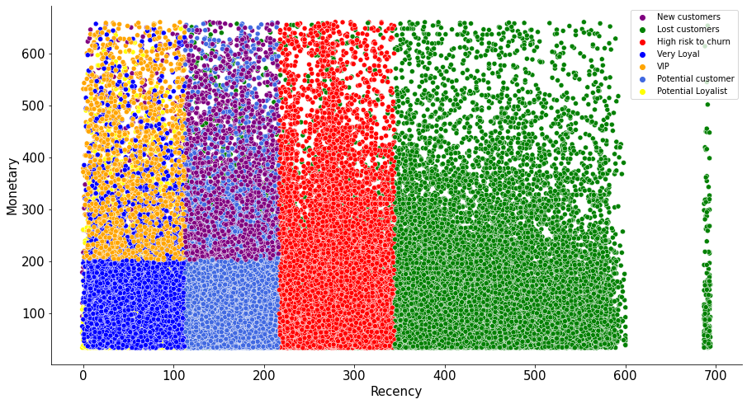
Customer Segmentation
( Customer Segmentation using RFM Analysis )

Slide 13
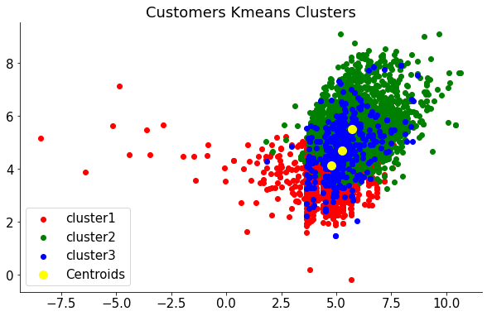
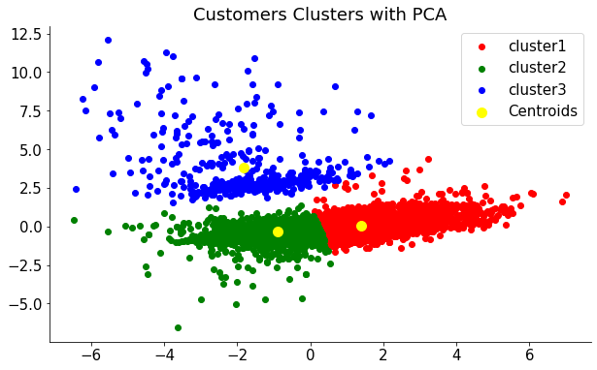
Customer Segmentation
( Customer Segmentation using K-Means )

Slide 14
Thank You

